Slide 1


CMR ENGINEERING COLLEGE
(UGC AUTONOMOUS)
(Accredited by NBA,Approved by AICTE NEW DELHI, Affiliated to JNTU, Hyderabad)
Kandlakoya, Medchal Road, Hyderabad-501 401.
Department of Computer Science & Engineering
A Mini Project
On
VISUALIZATION AND FORECASTING OF STOCK USING DASH
Presented By
N. Kireeti P. Shravani
Md. Mukhtar
D. Koushik
Internal Guide:-
Mr. K. Ramana Reddy , Associate Professor,
Dept. of CSE.
: (218R1A0546)
: (218R1A0552)
: (218R1A0543)
: (218R1A0510)
A.Y 2024-2025

Slide 2
Table of Content
Abstract
Introduction about Project
Literature survey
Existing System
Proposed System (Project Scope, Objectives, Modules)
Software Requirements
Hardware Requirements
System Architecture
System Design
Output Screen
Future Enhancement
Conclusion
References/Bibliography

Slide 3
Abstract
In today’s financial world, a big challenge is finding the best way to show and explain stock market predictions. These predictions help people make the most money from their investments. The stock market changes a lot, and it’s not easy to understand. Choosing to invest money for a long time is an important decision. But it’s tough to figure out the value of stocks and companies for such investments. Predicting stock prices is very interesting to people in finance and research because investing in stocks can give you high returns, even though prices can go up and down a lot. By looking at share prices and other numbers, smart investors can make good choices about where to put their money. There is a pressing need for tools that can effectively visualize these financial data and provide accurate predictions to guide investment decisions.

Slide 4
Introduction
Dash enables the creation of interactive and visually appealing dashboards that display stock price trends, volumes, and other metrics, allowing users to explore and analyze historical data easily.
By integrating forecasting models such as ARIMA, LSTM, or Prophet, Dash allows for predicting future stock prices, helping users make informed investment decisions based on projected trends.
Dash supports real-time data updates and offers high customization, ensuring the dashboards meet specific user needs and preferences while providing up-to-date market information.

Slide 5
Literature survey
AUTHORS NAME | PAPER TITLE | YEAR PUBLISHED | JOURNAL NAME | METHODOLOGY | OVERVIEW | ABSTRACT
Vikash Kumar, Khushbu Jain Arin Joshi, Ayush Mishra, Manvi Sharma | "Review on Visualization and Forecasting Stocks Using Dash" | 2024 | International Journal of Engineering Trends and Applications | Machine learning, ANN, Dash library | Combines data visualization and machine learning for accurate stock trend predictions. | Investing in the stock market presents challenges and rewards. Effective forecasting of price changes is essential.
Sleeba Mathew C, Ahmed Unaish, Mahammad Akbar | "An Efficient Model for Stock Price Forecasting using LSTM" | 2023 | Research and Reviews: Advancement in Robotics | LSTM models, Python's Dash, sequence prediction | LSTM models improve accuracy with larger datasets; sentiment analysis from social media | Predicting stock market trends is challenging due to numerous factors. ML algorithms using past stock price data can help.
Anjali Sunil | "Stock Price Prediction using LSTM Model and Dash" | 2021 | International Journal for Research in Applied Science & Engineering Technology | LSTM models, Dash, addressing limitations of linear regression | LSTM models provide precise forecasts, offering insights into future stock market situations, aiding investors | Stock market prediction involves determining the future value of a company's stock.

Slide 6
Literature survey
AUTHORS NAME | PAPER TITLE | YEAR PUBLISHED | JOURNAL NAME | METHODOLOGY | OVERVIEW | ABSTRACT
Sachin Kumar Mishra, Rishab Thakur, Shantanu Saha, Chitrangada Chaubey | "Visualizing and Forecasting Stocks Using Dash" | 2022 | International Journal of Advanced Research in Science, Communication and Technology (IJARSCT) | Machine Learning, Dash Python, yfinance, Predictions, Deep Learning, LSTM, RNN | Visualization and forecasting techniques assist investors with accurate stock market predictions. The model can be extended for more features in the future. | In stock market it is very hard to predict the stock prices as there are no clear cut rules of prediction, but it provides one of the highest returns in the market.
Ranjan Kumar Dash, Tu N. Nguyen, Korhan Cengiz, Aditi Sharma | "Fine-tuned Support Vector Regression Model for Stock Predictions" | 2021 | Neural Computing and Applications | Support Vector Regression (SVR), Grid Search, Root Mean Square Error (RMSE), | The proposed SVR model is more accurate and time-efficient than other methods. | A new ML technique using fine-tuned support vector regression (SVR) for stock forecasting.

Slide 7
Existing system
Current systems require using multiple tools for data collection, analysis, visualization, and forecasting.
This leads to inefficiencies and potential errors, as users have to manually transfer data and switch between different applications.
Reports generated are static, limiting interactive analysis and insights.
System lacks predictive models to forecast market trends.
Data processing and visualization are time-consuming.

Slide 8
Proposed System
Enhance user experience and accuracy of stock predictions with an intuitive Dash interface.
Easily navigate through various stock data visualizations with dynamic line charts, bar charts, and interactive candlestick plots.
Continuously update stock prices from reliable APIs like Yahoo Finance for real-time data.
Incorporate advanced machine learning models (SVR, LSTM) for precise future stock price predictions.
Customize predictions by selecting specific stocks, time frames, and forecasting models.

Slide 9
Objective of the Project
To create an interactive dashboard for visualizing stock data.
To implement forecasting models for predicting stock price trends.
To automate the process of collecting and preparing stock data for analysis.
To improve efficiency in analyzing stock market data and trends.

Slide 10
Software Requirements
Operating System | Windows 10/11, macOS
Development Software | Python 3.12.0
Programming Language | Python
Domain | Machine Learning
Integrated Development Environment (IDE) | Visual Studio Code
Libraries and Frameworks | Dash, numpy, pandas, yfinance, scikit – learn, plotly
API | Yahoo Finance API
Web Server or Deployment Server | Flask
Design/Modelling | Star UML

Slide 11
Hardware Requirements
MINIMUM (Required for Execution) |  | MY SYSTEM (Development)
System | Intel Core i5 or equivalent | Intel Core i5
Hard Disk | 100 GB | 500 Gb
Ram | 4 Gb | 4 Gb
Graphics | Integrated Graphics | Dedicated Graphics

Slide 12
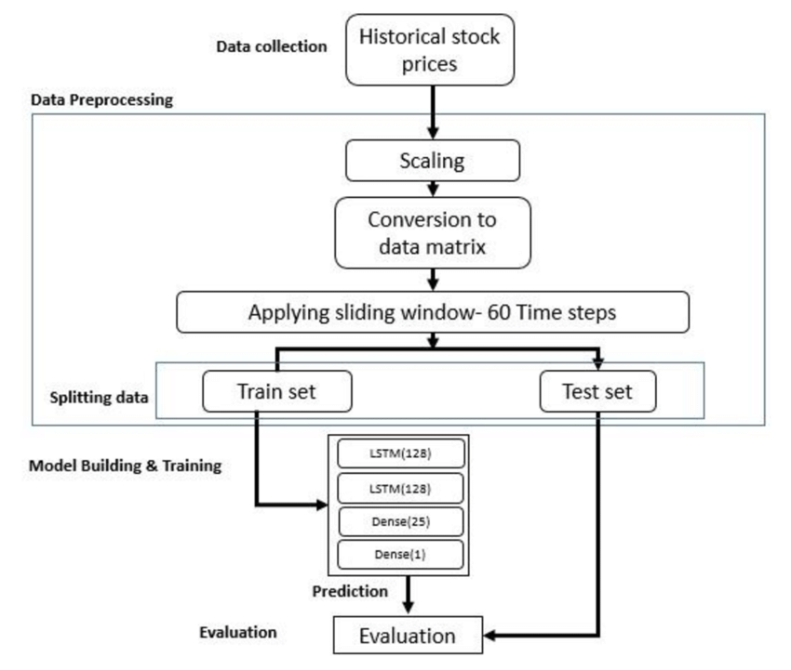
SYSTEM ARCHITECTURE

Slide 13
SYSTEM DESIGN

Slide 14
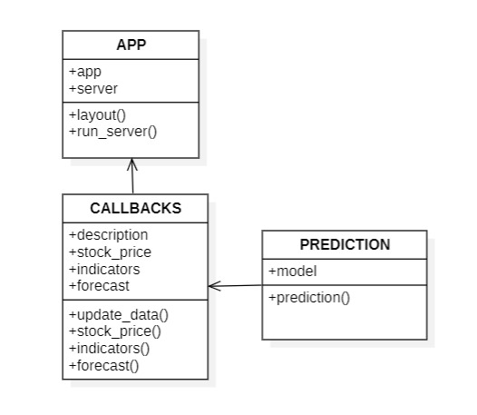
UML diagrams Class diagram:

Slide 15
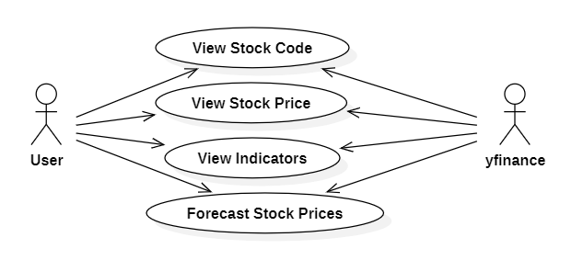
Use case diagram

Slide 16
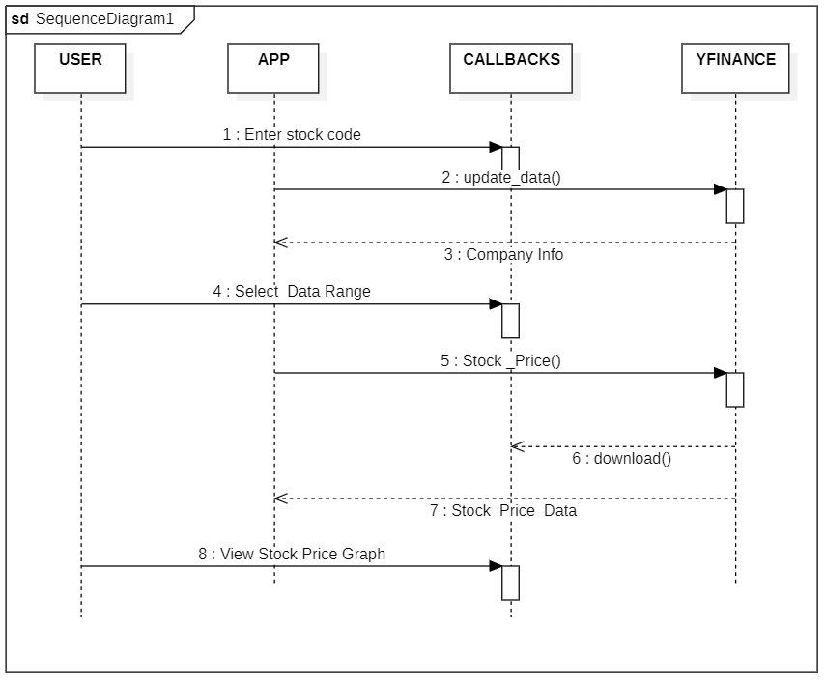
Sequence Diagram

Slide 17
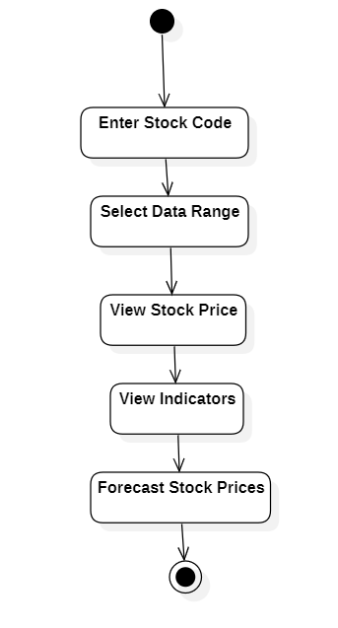
Activity diagram

Slide 18
Testing strategies:
Unit Testing
Functionality of Individual Components: Write tests for individual functions that handle data retrieval, data processing, and visualization.
Forecasting Algorithms: Test the statistical or machine learning models separately. This can include testing the ARIMA model, LSTM, or any regression model used.
Visualization Functions: Ensure that the rendering functions generate charts and graphs with expected properties (correct labels, scales, axes, colors).

Slide 19
System Testing System testing is types of testing where tester evaluates the whole system against the specified requirements. a)End to End Testing It involves testing a complete application environment in a situation that mimics real-world use, such as interacting with a database, using network communications, or interacting with other hardware, applications, or systems if appropriate. b) Black Box Testing Blackbox testing is a software testing technique in which testing is performed without knowing the internal structure, design, or code of a system under test. Testers should focus only on the input and output of test. objects.

Slide 20
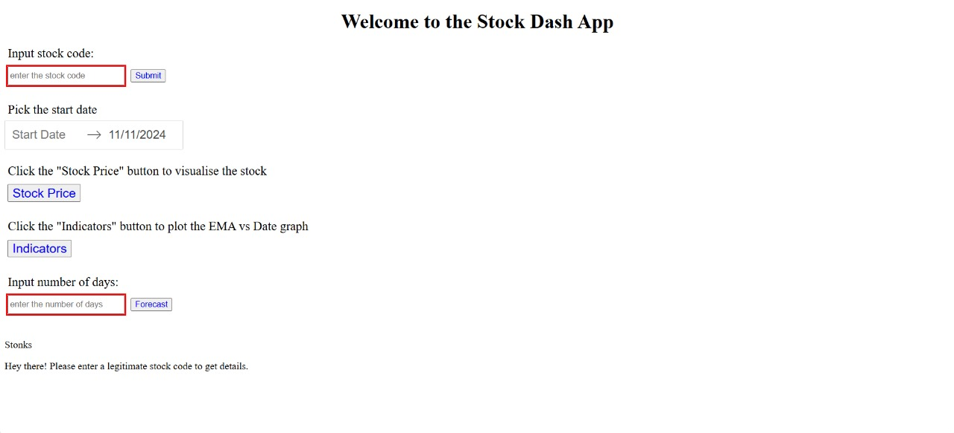
OUTPUT SCEREENS

Slide 21
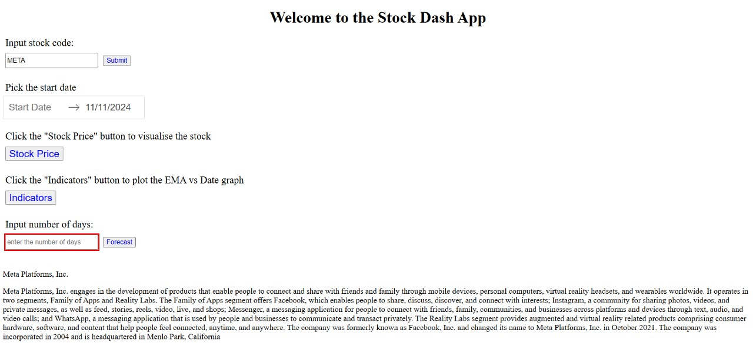

Slide 22
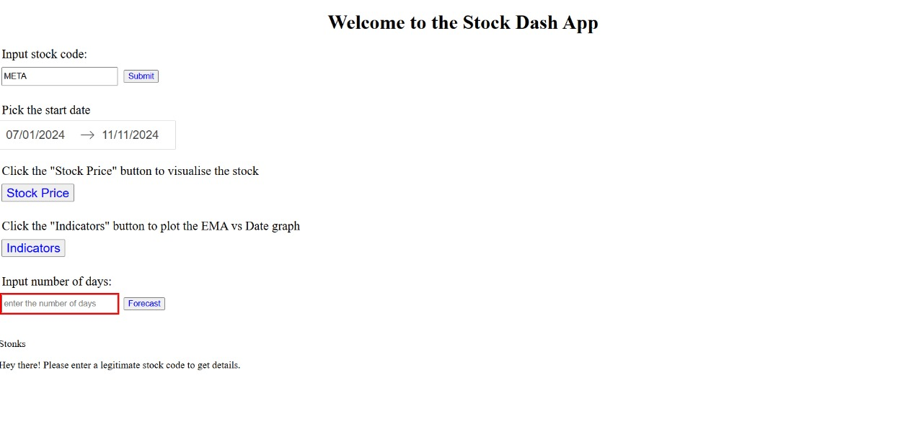

Slide 23
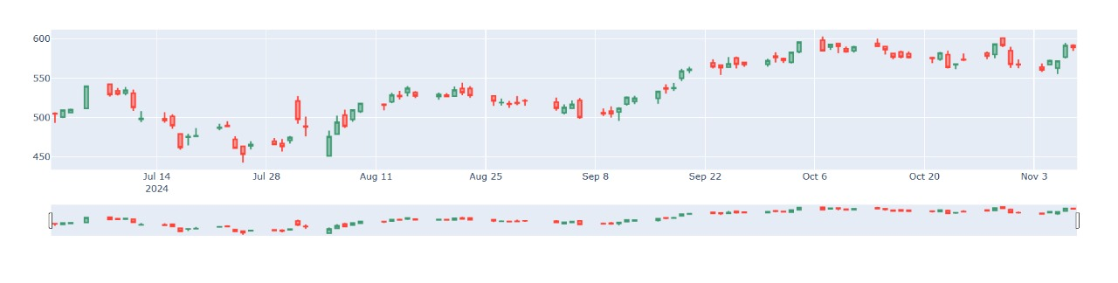

Slide 24
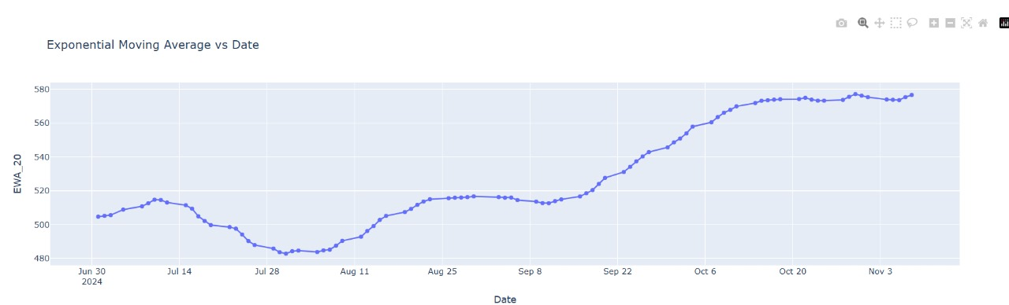

Slide 25
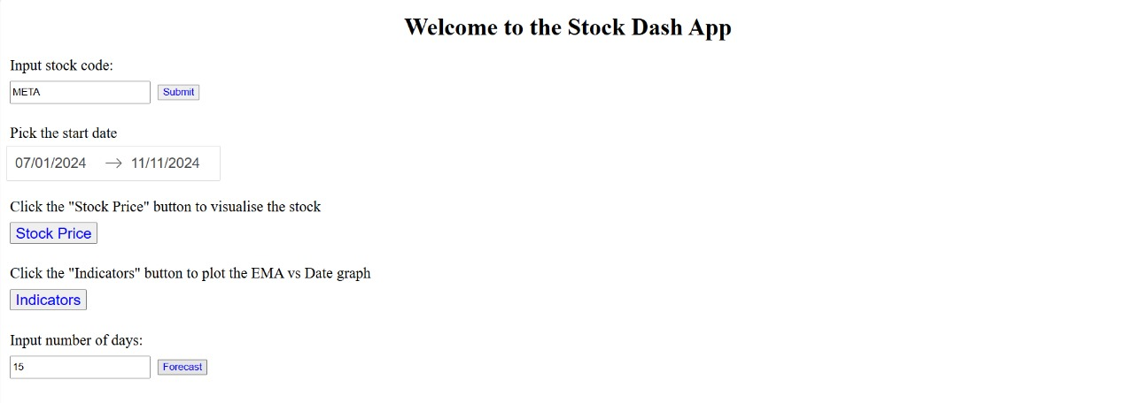

Slide 26
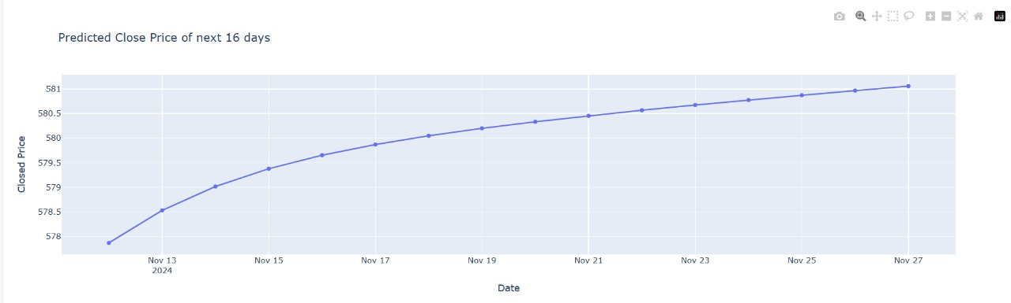

Slide 27
Future Enhancement:
Future enhancements for a stock visualization and forecasting application built in Dash could focus on both advanced analytical capabilities and user experience improvements.
Introducing AI-driven predictive models, such as deep learning models like LSTMs or attention-based transformers, could significantly enhance forecasting accuracy, particularly for volatile markets.
Additionally, expanding data sources to include alternative data like news sentiment analysis, social media trends, and macroeconomic indicators could provide a more comprehensive perspective on market drivers.

Slide 28
Conclusion
"Stock Visualization and Forecasting using Dash" empowers users with interactive tools to analyze and predict stock market trends.
By leveraging Dash's capabilities, users can create dynamic visualizations and implement forecasting models to make informed investment decisions.
This approach enhances data accessibility, enables real-time analysis, and supports strategic planning in the financial domain.
The integration of visualization and forecasting in a single platform streamlines decision-making and provides valuable insights for both individual and institutional investors.

Slide 29
References /Bibliography
[1] Kumar V., Jain K., Joshi A., Mishra A., & Sharma M. (2024). Review on visualization and forecasting stocks using dash. International Journal of Engineering Trends and Applications.
[2] S. M. C., Unaish A., Akbar M., Ishan M., & Raza M. D. (2023). An efficient model for stock price forecasting using LSTM. Research and Reviews: Advancement in Robotics.
[3]Sunil A. (2021). Stock price prediction using LSTM model and Dash. International Journal for Research in Applied Science & Engineering Technology.
[4] Mishra S. K., Thakur R., Saha S., & Chaubey C. (2022). Visualizing and forecasting stocks using Dash. International Journal of Advanced Research in Science, Communication and Technology.
[5] Kumar R., Nguyen T. N., Cengiz K., & Sharma A. (2021). Fine-tuned support vector regression model for stock predictions. Neural Computing and Applications.

Slide 30
THANK YOU

